Slide 1
Sales Performance Analysis Report Supermarket Transaction Data (2024)
Prepared by Ademola Abraham
Date MARCH 2026
Business Intelligence & Data Analytics Report

Slide 2
Business Problem
The supermarket management team provided one year of transaction data to better understand business performance and customer purchasing behavior across its branches.
The goal of this analysis is to uncover insights that can help management make informed decisions to improve sales performance, product strategy and customer experience.
Key Questions
How did sales perform across the different branches?
Which product lines generated the highest revenue?
What are the purchasing patterns of different customer groups?
Which payment methods are most commonly used?
What does customer rating reveal about service satisfaction?
Purpose of the Analysis
To transform transaction data into actionable insights that support better business decisions.

Slide 3
Dataset Overview
Dataset Description
The dataset contains one year of supermarket transaction records covering sales activities across multiple branches. Each row represents a single customer transaction recorded during 2024.
Dataset Summary
Time Period: January 2024 – December 2024
Total Transactions: 5,053
Number of Variables: 9
Branch Locations: Brooklyn, Queens, Manhattan
Key Variables
Date ---- Transaction date
Branch --- Store location
Customer Type --- Member or Normal customer
Gender --- Customer gender
Product Line --- Product category purchased
Unit Price --- Price of the product
Quantity --- Number of items purchased
Payment --- Payment method used
Rating --- Customer satisfaction rating

Slide 4
Data Preparation
Before performing the analysis, the dataset was reviewed to ensure its quality and readiness for exploration.
The dataset was found to be well-structured with no missing values, duplicates or inconsistencies.
Preparation Steps
Imported the dataset into Python using Jupyter Notebook
Inspected the dataset structure and variables
Verified data completeness and consistency
Adjusted data types of columns to appropriate formats for analysis
This preparation ensured the dataset was ready for accurate exploratory data analysis and visualization.

Slide 5
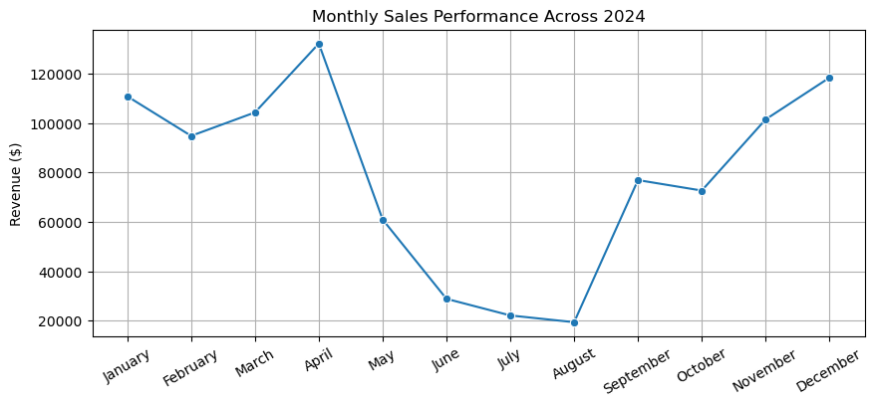
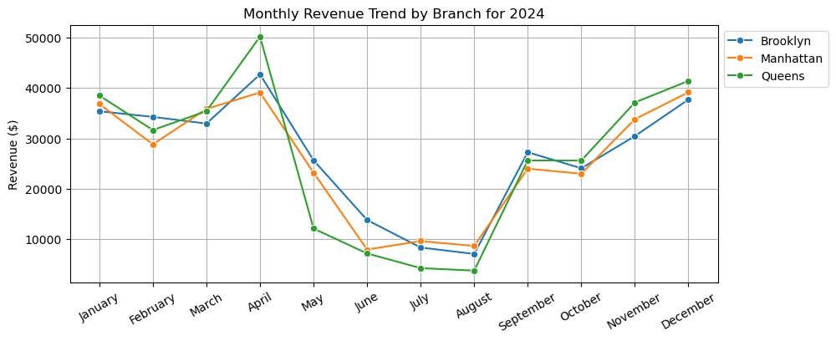
A. Overall Sales Performance (2024)
Key Metric
Total Revenue Generated in 2024 $942,544.85
Key Insights
Sales fluctuated throughout the year, showing clear seasonal patterns.
April generated the highest revenue ($132,083.88), indicating strong year-end sales.
August recorded the lowest revenue ($19,440.15), suggesting a significant mid-year slowdown.
Revenue began recovering from September and remained strong toward the end of the year.

Slide 6
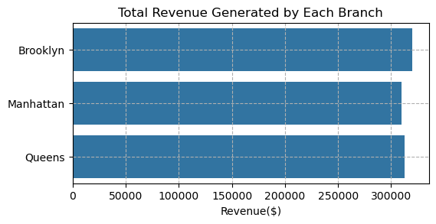
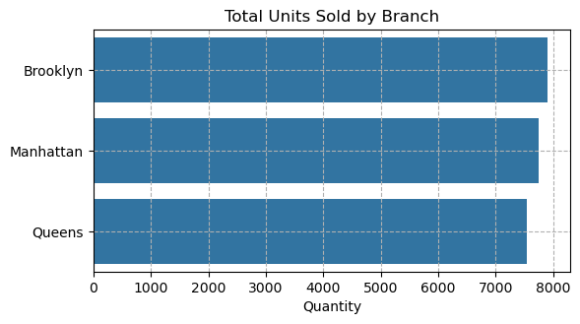
B. Branch SALES Performance
Key Insights
Sales performance across branches is relatively balanced.
Brooklyn recorded the highest revenue, though only slightly above the other branches.
Manhattan and Queens show similar performance levels, indicating consistent sales distribution.
The quantity of products sold is also closely aligned across branches, reinforcing the balanced performance.

Slide 7
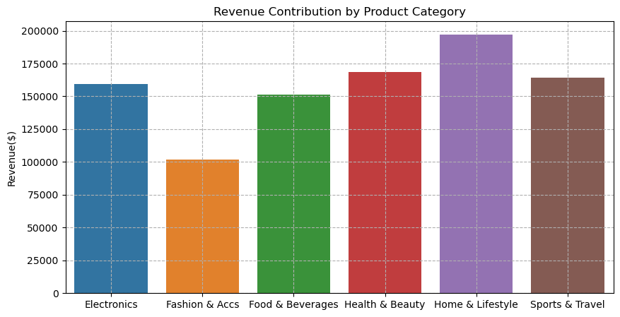
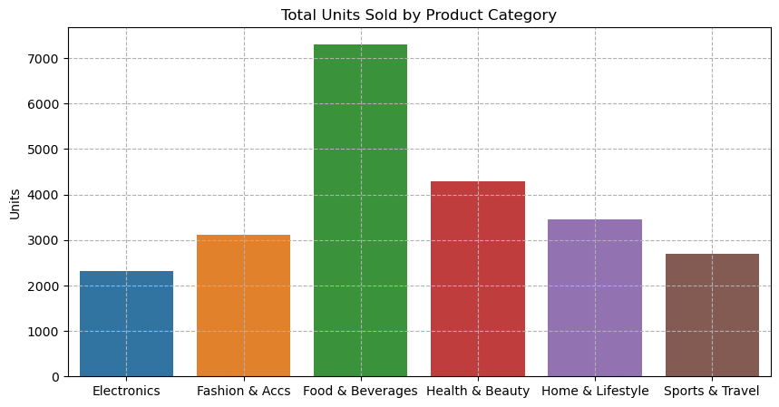
c. Product Line Performance
Key Insights
Home & Lifestyle generated the highest revenue, making it the top-performing category.
Fashion & Accessories produced the lowest revenue, significantly below other product lines.
Food & Beverages recorded the highest quantity sold (7,309 units), showing strong customer demand.
Despite high sales volume, Food & Beverages generates moderate revenue, suggesting lower unit prices compared to other categories.

Slide 8
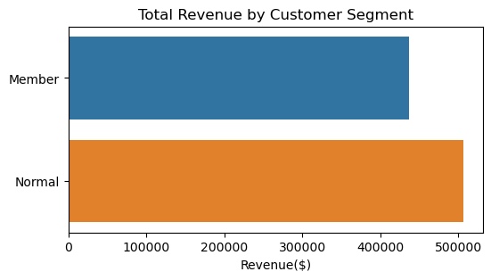
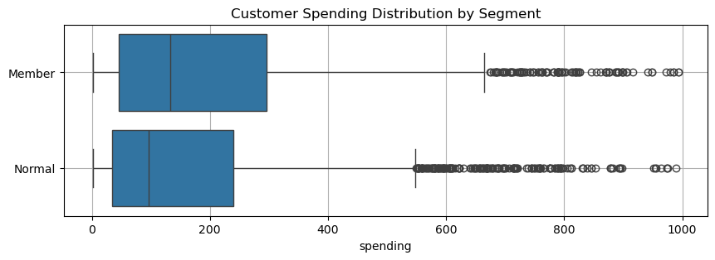
d. Customer Segment Analysis
Key Insights
Normal customers generated higher total revenue during the year.
However, members tend to spend more per transaction compared to normal customers.
Spending distribution shows members consistently spending higher amounts across percentiles.
This suggests that while normal customers visit more frequently, members generally make larger purchases per visit.

Slide 9
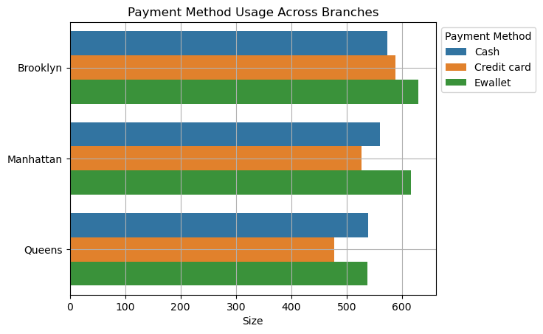
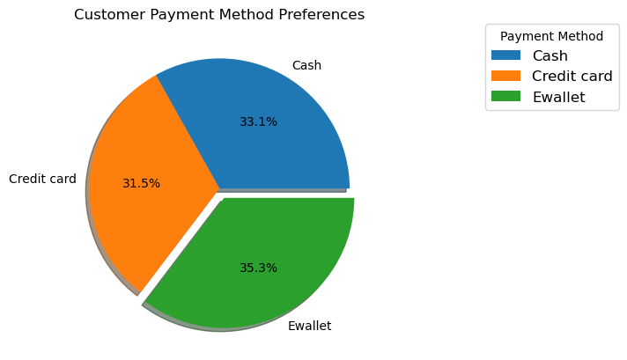
E. Payment Method Analysis
Key Insights
E-wallet is the most frequently used payment method, indicating strong adoption of digital payments.
Cash and credit card usage are very close in frequency, showing that customers still rely on traditional payment methods.
The distribution across payment types is fairly balanced overall.
Branch-Level Observation
Payment preferences across Brooklyn, Manhattan and Queens show similar patterns.
No branch demonstrates a strong preference for a particular payment method.

Slide 10
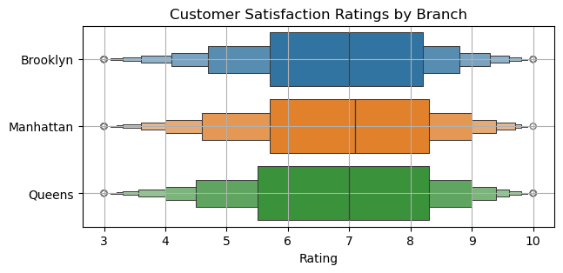
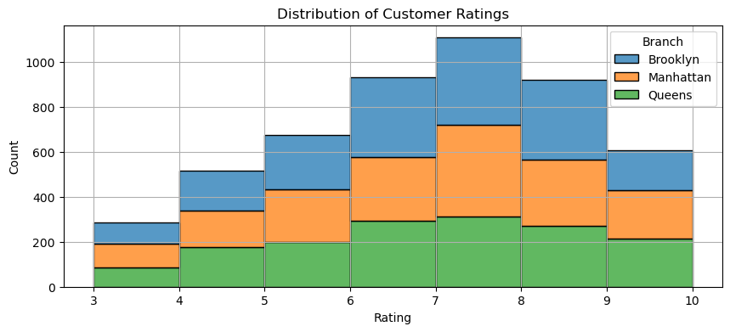
f. Customer Satisfaction Analysis
Key Insights
Customer ratings generally fall between 6 and 8, indicating moderate satisfaction levels.
All branches show very similar rating distributions, suggesting consistent service quality across locations.
There is no branch that significantly outperforms or underperforms in customer satisfaction.
Additional Observation
Most ratings cluster between 7 and 9, showing that many customers have positive experiences, although there is still room for improvement.

Slide 11
Key Insights from the Analysis
Sales Performance
The supermarket generated $942,544.85 in total revenue during 2024.
Sales were strongest toward the end of the year, with December recording the highest revenue.
Mid-year months showed a noticeable sales decline, particularly in July and August.
Branch Performance
Sales performance across Brooklyn, Queens and Manhattan is relatively balanced.
No branch shows significant underperformance, indicating consistent operations across locations.
Product Performance
Home & Lifestyle generated the highest revenue, making it the top-performing category.
Food & Beverages recorded the highest number of units sold, suggesting strong demand but lower pricing.
Fashion & Accessories generated the lowest revenue, indicating weaker product performance.

Slide 12
Key Insights from the Analysis
Customer Behavior
Normal customers generated more total revenue, likely due to a higher number of transactions.
Members spend more per purchase, indicating stronger spending behavior per visit.
Payment Trends
E-wallet is the most frequently used payment method, showing increasing adoption of digital payments.
Customer Satisfaction
Average customer rating is 6.9, indicating moderate satisfaction levels.
Customer satisfaction levels are consistent across all branches.

Slide 13
Business Recommendations
1. Strengthen High-Performing Product Lines
Focus inventory and marketing efforts on Home & Lifestyle, Health & Beauty, and Sports & Travel, as these categories generate strong revenue.
2. Improve Underperforming Categories
Develop promotional campaigns or product improvements for Fashion & Accessories to increase sales performance.
3. Leverage Membership Programs
Since members tend to spend more per transaction, the company should promote membership programs to encourage higher spending.
4. Support Digital Payment Adoption
Given the popularity of E-wallet payments, the business can enhance digital payment options and offer promotions for digital transactions.
5. Address Mid-Year Sales Slowdown
Introduce seasonal promotions or marketing campaigns during mid-year months to stabilize sales performance.
6. Improve Customer Experience
Although satisfaction levels are consistent across branches, efforts should be made to increase customer ratings above current averages through improved service and customer engagement.

Slide 14
THANK YOU
QUESTIONS & DISCUSSION
Prepared by Ademola Abraham

